Slide 1
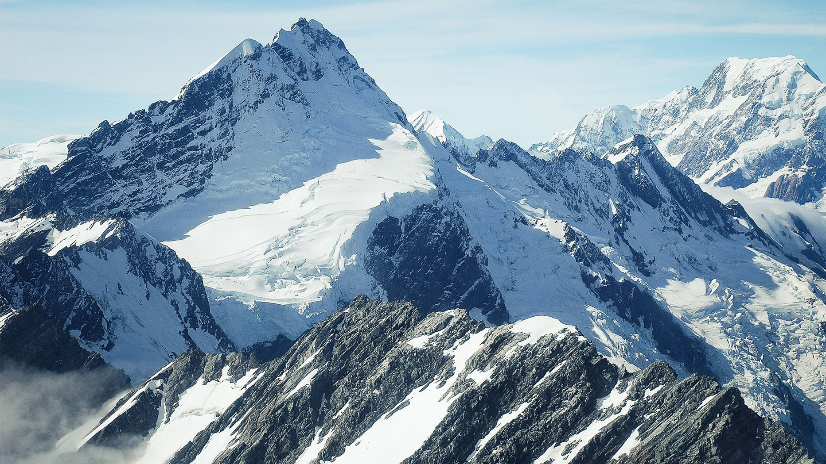
Predicting Pollution From Weather
CRVENO PIVO

Slide 2
Data problems and solutions 📈

Slide 3
Machine learning 🤖 approach

Slide 4
Training 💪

Slide 5
Final products
Android App
Website

Slide 6
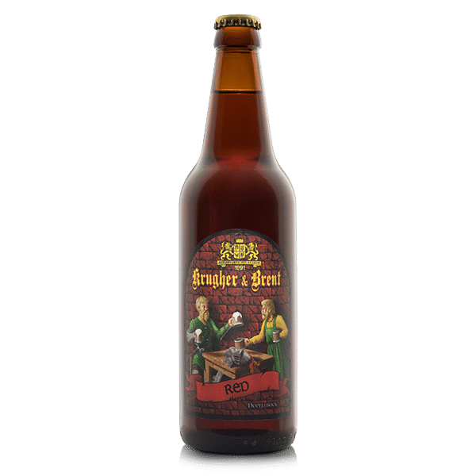
Thank you for attention
Crveno Pivo

